Slide 1
Team Assignment
Team 2

Slide 2
Problem Statement
As the manufacturing of bottles are outsourced, management feels that it is essential to perform quality inspection of the manufactured bottles. They have highlighted two crucial dimensions for inspection:
(1) The diameter of the mid-section of the body and
(2) the diameter of the bottle cap.
Diameter of the bottle cap, D30 ± 0.4 mm
As highlighted above, we will recording, observing and calculating data based on the diameter of the bottle caps.

Slide 3
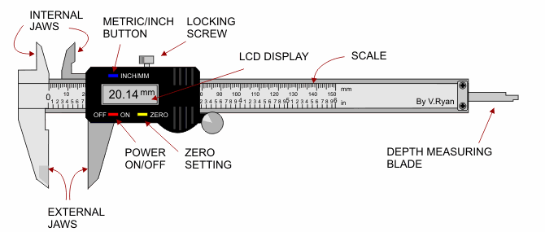
Background Research (Method of Measurement)
Vernier callipers, an instrument for making very accurate linear measurements was introduced in 1631 by Pierre Vernier of France. Vernier callipers are widely used in scientific laboratories and in manufacturing for quality control measurements

Slide 4
Background Research (Method of Measurement)
Uses of a vernier callipers Vernier callipers are used to measure (i)The length of a rod or any object (ii)The diameter of a sphere (iii)The internal and external diameter of a hollow cylinder (iv)The depth of a small beaker

Slide 5
Background Research (Method of Measurement)
Preparations
1. Slider can be removed only after the locking screw (10) is loosened.
2. Check to see if all the buttons, switches and LCD are responsive.
These steps were very important as it was to ensure that the consistency and reliability of the recorded data.

Slide 6
Background Research (Method of Measurement)
Basic Measuring Methods
1. Loosen the locking screw.
2. Switch the unit on with a press of the ON button. Then select the measuring units needed by pressing the Inch/Metric button.
3. Apply normal measuring pressure on the slider to close the external measuring jaws. Then press the “ZERO” button to reset the display to zero.
The external jaws were used to record the data.

Slide 7
Our assumptions
The vernier calliper is accurate hence the results are accurate.
We assume that the number of trials is fixed to 24.
We assume that success -> caps that failed inspection, not success -> passed inspection.

Slide 8
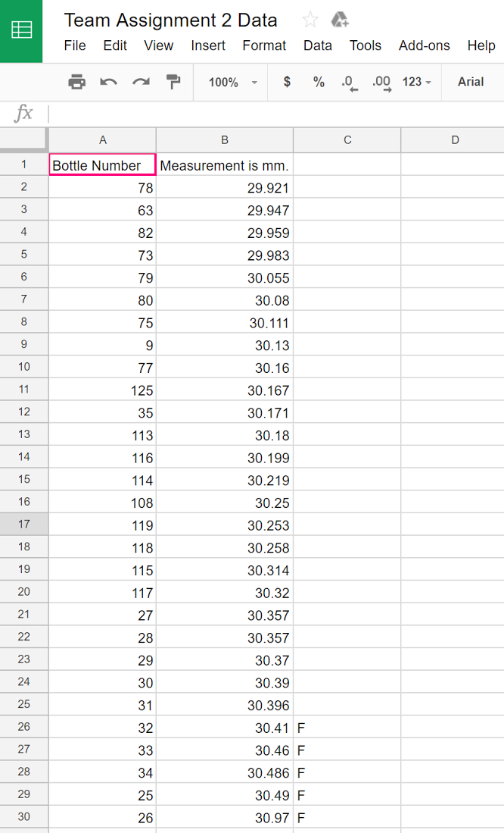
Raw Data
19 passes, 5 fails
Therefore the proportion of bottles with the measurement that fail inspection is 5/24. (20.83333333%)

Slide 9
In a randomly chosen packed cartons of 24 bottles each...
n = 24
p = 0.2083333333
Success → failed inspection, Not success → passed inspections
X ~ B ( 24,0.2083333333)

Slide 10
What is the probability that not more than 3 bottles fail inspection?
P(x<=3)
Ans: Binom. Dist. Range (24,0.2083333333,0,3)= 0.23(2dp)
What is the probability that more than 5 bottles fail inspection?
P(x>5)
Ans: Binom. Dist. Range (24,0.2083333333,6,24)= 0.38(2dp)

Slide 11
What is the probability that between 2 and 7 bottles (inclusive of both ends) failed inspection?
P(2=<x<=7)
Ans: Binom. Dist. Range = (24,0.2083333333,2,7)= 0.89(2dp)
What is the expected number of bottles that fail inspection?
Ans:np = 24x0.2083333333
= 5

Slide 12
What is the standard deviation of number of bottles that fail inspection?
Ans: stdev.= sqrt[np(p-1)]
= sqrt[5(1-0.2083333333)]
= 1.99(2dp)

Slide 13
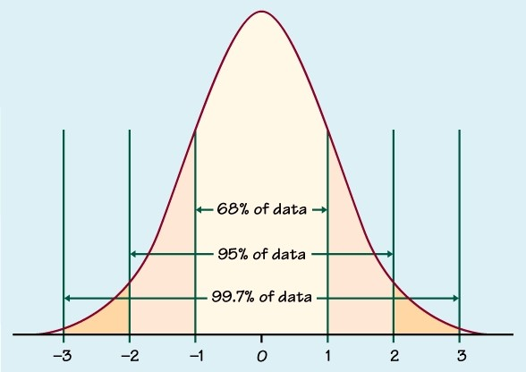
Normal Distribution Graph
Normal distributions are symmetric around their mean.
The mean, median, and mode of a normal distribution are equal.
The area under the normal curve is equal to 1.0.
Normal distributions are denser in the center and less dense in the tails.
Normal distributions are defined by two parameters, the mean (μ) and the standard deviation (σ).
68% of the area of a normal distribution is within one standard deviation of the mean.
Approximately 95% of the area of a normal distribution is within two standard deviations of the mean.

Slide 14
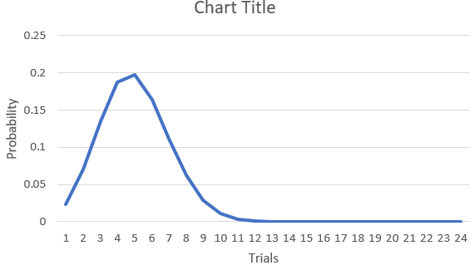
What is the most likely number of bottles that fail inspection?
Ans:5
Based on the graph, the highest peak(mean) is 5, therefore the most likely number of bottles that fail inspection is 5.

Slide 15
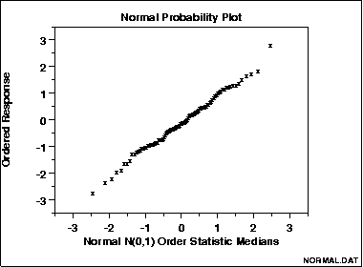
Interpret the Results (Method #1)
The data are plotted against a theoretical normal distribution in such a way that the points should form an approximate straight line.
Vertical axis: Response values Horizontal axis: Statistic medians
One advantage of this method of computing probability plots is that the intercept and slope estimates of the fitted line are estimates for the location and scale parameters of the distribution.

Slide 16
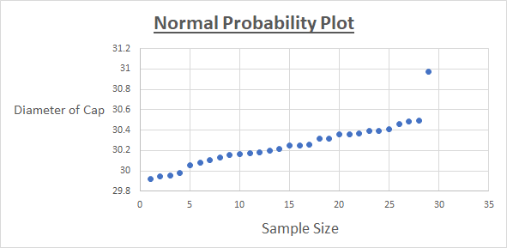
Interpret the Results (Method 1)
In this plot, the data points fall closely to form a seemingly straight line. We can assume that the data follows a binomial distribution.

Slide 17
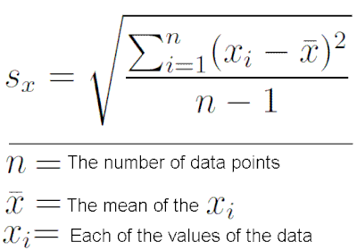
Interpret the Results (Method 2)
The Standard Deviation is a measure of how spread out numbers are. The standard deviation is a summary measure of the differences of each observation from the mean.

Slide 18
Interpret the Results (Method 2)
As calculated earlier,
S.D. = 1.99
A low standard deviation means that most of the numbers are very close to the average. A low standard deviation indicates that the data are clustered closely around the mean (more reliable).

Slide 19
Conclusion
Based on the normal probability, the data follows a binomial distribution as it forms the shape of a straight line.
We obtained a low standard deviation and this means that the data closely around the mean (more reliable).
Based on the P-chart, even though the acceptable range is 30 ± 0.4 mm, it may not be applicable to our population sample as the P-chart indicates there could also be inconsistencies in our measurement. However, this is not proven as we only recorded a total of 29 samples.

Slide 20
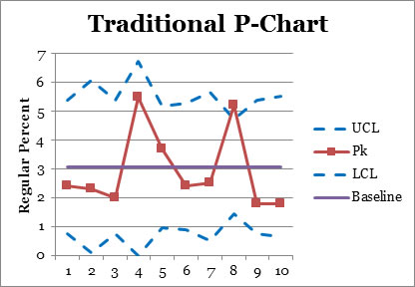
Suggestions
When you are interested in comparing multiple sample means, you can use the analysis of means (ANOM) as an alternative to the one-way analysis of variance test.

Slide 21
Suggestions
The ANOM provides a “confidence interval type of approach” that allows you to determine which, if any, of the groups has a mean significantly different from the overall average of all the sample means combined.
Instead of looking at the lower and upper quartiles, we will be studying which of the sample means are not contained in an interval formed between a lower decision line and an upper decision line.
Any individual sample mean not contained in this interval is deemed significantly higher than the overall average of all groups if it lies above the upper decision line. Similarly, any group mean that falls below the lower decision line is declared significantly lower than the overall group average.

Slide 22
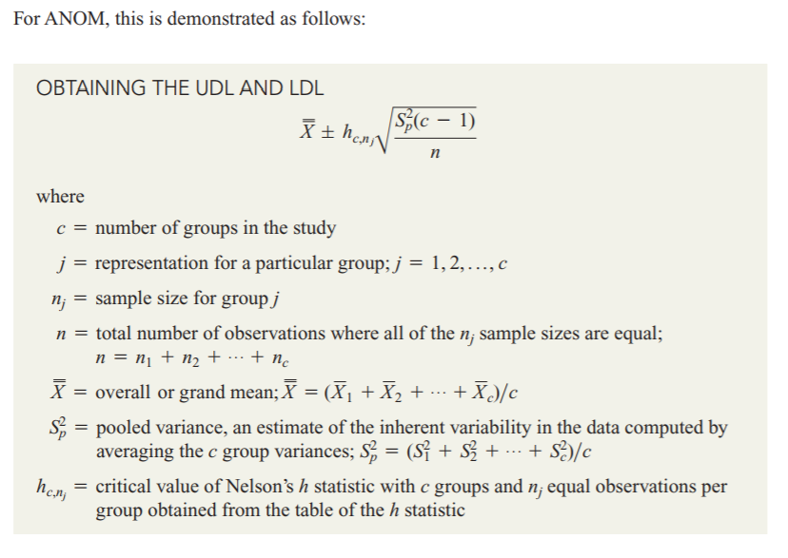
Suggestions
Or using Excel;
“QiMacros” 2017 Extension
We used this method to create a “P” Chart.

Slide 23
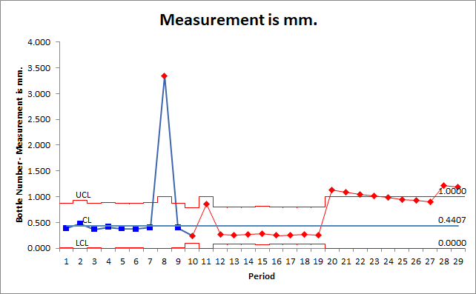
Based on our results, if we were to define the acceptable range based on just the sample means, there is a possibility of 21 defective bottles from the original 29 recorded samples. This means that the defective range provided might not be applicable to our data.

Slide 24
Thank You :)

